Slide 1

AIS PoC Test Procedure - Topic 16
AWS Infrastructure (FEEDBACK)
MEGAZONE CLOUD | Cloud Technology Center

Slide 2


Test Case #1
Infrastructure as a Service (IaaS)

Slide 3
Test Case #1
Infrastructure as a Service (IaaS)
PoC Detail
Explain the process and concepts involved in creating and managing AWS services, such as virtual machines (EC2 instances), using Infrastructure as a Service (IaaS).
Expected Result
The proposed solution should explain the process and concepts involved in creating and managing AWS services, such as virtual machines (EC2 instances), using Infrastructure as a Service (IaaS).

Slide 4
Test Case #1
Infrastructure as a Service (IaaS)
Questions
none

Slide 5
Test Case #2
Containerization

Slide 6
Test Case #2
Containerization
PoC Detail
- Explain the process and concepts involved in deployment and management of containers using AWS Fargate or Amazon ECS.
- Explain the process and concepts involved in integration with container orchestration tools e.g. EKS.
Expected Result
- The proposed solution should explain the process and concepts involved in deployment and management of containers using AWS Fargate or Amazon ECS.
- The proposed solution should explain the process and concepts involved in integration with container orchestration tools e.g. EKS.

Slide 7
Test Case #2
Containerization
Questions
1. Why leveraging the Managed worker node group instead of Fargate?
EKS Managed worker node group advantages over Fargate
Advantages
Reduce management complexity
No need to manage nodes directly
Manage workload cost-effectively
Billing based on Pod execution time
If running batch pods
Possible isolated by VM-level
No sharing of resources like CPU, memory, etc with other pods.
Disadvantages
Not supported for DaemonSet.
If you have a configuration that relies on an existing DaemonSet, need to use a sidecar(Logging, Metric, etc)
Exist resource constraints.
Max 16vCPU & Max 120GB memory
Not support for GPU Usage
It must be configured the target groups by IP rather than node to ALB or NLB.
Cannot be utilized for Pods granted additional permissions.
Not available in Privileged pods and host networks, etc.
Can only run on private subnets not directly connected to the Internet gateway.

Slide 8





Test Case #2
Containerization
Amazon EC2 Runtime Options - Fargate
Customer VPC (10.0.0.0/16)
AWS Fargate
Fargate MicroVM
AWS Fargate
10.0.1.14
Kubernetes Pod
Considerations
Secure isolation of Tasks by running a dedicated kernel without shared CPU, memory, or storage.
DaemonSets are Not Supported on fargate
Only supports Application Load Balancers
Privileged Containers are Not Supported
Do not support host networking
Can only run within private subnets
Right—sized instances based CPU and Memory requests within the pod specification.
AWS manages the patching and upgrading of the underlying infrastructure, you manage the container
AMD Backed Instances
Graviton 2 Instances
Spot Instances and
Compute Savings Plans
AWS Outpost
AWS Local Zones

Slide 9









Test Case #2
Containerization
Amazon EC2 Runtime Options - EC2 Instance
Self-Managed Node Groups
Managed Node Groups
Bring your own Autoscaling Groups running your own custom AMI. You are responsible for patching and the underlying OS.
Provisioned by EKS in your VPC. They run the latest EKS optimized AMI. Handles automatic draining and rolling out new AMIs.
Runtime Options
GPU Based Instances
Nitro Based Instances
AMD Backed Instances
Graviton 2 Instances
Spot Instances and
Compute Savings Plans
AWS Outpost
AWS Local Zones

Slide 10
Test Case #2
Containerization
EKS Worker Node Types - Self-managed nodes
Customer Data
With a self-managed node group, if we try to update the worker node (e.g., for OS patch update, etc.), k8s will drain the node. It will kill POD, and then it will start updating the node. It results in application downtime. It is the user’s responsibility to manage HA. Doing this is more complicated. In reality, the production cluster is more complex, running thousands of nodes.
Container Images, Source Code, IAM
Controller Manager
API Server
Scheduler
HPA & VPA
Cluster Add-Ons
Network Policies
Quotas & Limit Ranges
Pod Disruption Budgets
RBAC Bindings
QOS and Pod Priority
Pod Security Policies
Kubernetes Control Plane
ETCD
EKS Cluster Configuration
Worker Node Scaling
VPC Configuration
OS, Kubelet, CRI & AMI, AMI Configuration
Customer Responsibility
AWS Responsibility
Notes:
https://aws.amazon.com/blogs/industries/fsi-services-spotlight-featuring-amazon-eks/

Slide 11
Test Case #2
Containerization
EKS Worker Node Types - Managed node groups
Customer Data
This model gives developers the freedom to manage not only the workload but also the worker nodes. Worker nodes consist of a group of virtual machines. However, the control manager is always managed by AWS.
Container Images, Source Code, IAM
Controller Manager
API Server
Scheduler
HPA & VPA
Cluster Add-Ons
Network Policies
Quotas & Limit Ranges
Pod Disruption Budgets
RBAC Bindings
QOS and Pod Priority
Pod Security Policies
Kubernetes Control Plane
ETCD
EKS Cluster Configuration
Worker Node Scaling
VPC Configuration
OS, Kubelet, CRI & AMI, AMI Configuration
Customer Responsibility
AWS Responsibility

Slide 12
Test Case #2
Containerization
EKS Worker Node Types - Fargate
Customer Data
This model has been designed to give developers the possibility to concentrate only on their workload, pod configurations, and application logic, without worrying about the infrastructure management, availability, fault tolerance, scaling, and patching of host machines. Therefore the control manager and worker nodes are managed by AWS.
Container Images, Source Code, IAM
Controller Manager
API Server
Scheduler
HPA & VPA
Cluster Add-Ons
Network Policies
Quotas & Limit Ranges
Pod Disruption Budgets
RBAC Bindings
QOS and Pod Priority
Pod Security Policies
Kubernetes Control Plane
ETCD
EKS Cluster Configuration
Worker Node Scaling
VPC Configuration
OS, Kubelet, CRI & AMI, AMI Configuration
Customer Responsibility
AWS Responsibility

Slide 13
Test Case #3
Serverless Computing

Slide 14
Test Case #3
Serverless Computing
PoC Detail
- Explain the process and concepts involved in developing and deploying serverless functions with AWS Lambda.
- Explain the process and concepts involved in scaling and response times for serverless functions.
Expected Result
- The proposed solution should explain the process and concepts involved in developing and deploying serverless functions with AWS Lambda.
- The proposed solution should explain the process and concepts involved in scaling and response times for serverless functions.

Slide 15
Test Case #3
Serverless Computing
Questions
1. How to use Lambda service in this project?
aws backup lambda use case reference
How to Automate AMI Backups & Cleanups, using AWS Lambda
https://www.bluepiit.com/blog/how-to-automate-ami-backups-cleanups-using-aws-lambda-serverless-with-ec2-tags/
aws alarm lambda use case reference
Lambda function to programmatically create AWS CloudWatch alarm | medium
https://vabnix.medium.com/lambda-function-to-programmatically-create-aws-cloudwatch-alarm-9c5baab121b1

Slide 16
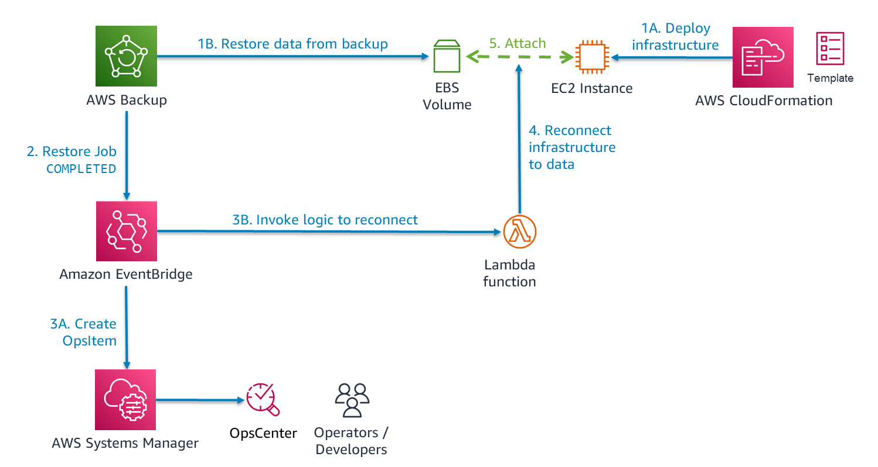
Test Case #3
Serverless Computing
Use cases
Automating integration of infrastructure and data as part of restoring a workload
Notes:
aws backup lambda use case reference
How to Automate AMI Backups & Cleanups, using AWS Lambda
https://www.bluepiit.com/blog/how-to-automate-ami-backups-cleanups-using-aws-lambda-serverless-with-ec2-tags/
aws alarm lambda use case reference
Lambda function to programmatically create AWS CloudWatch alarm | medium
https://vabnix.medium.com/lambda-function-to-programmatically-create-aws-cloudwatch-alarm-9c5baab121b1

Slide 17









Test Case #3
Serverless Computing
Container Images: Automate compliance with image scanning
AWS Cloud
Image blocked (Critical or high CVE)
ECR Permission Policy
AWS Lambda
Security Hub
Custom action
Image push
Image CVE
findings
Container Image
Amazon ECR
Amazon CloudWatch
AWS Lambda
AWS Security Hub
Medium or low CVE

Slide 18
Test Case #4
Storage and Databases

Slide 19
Test Case #4
Storage and Databases
PoC Detail
Explain the process and concepts involved in
1. Store data in Amazon storage e.g. S3 and assess its scalability and durability.
2. Set up and manage relational databases e.g. RDS.
3. Evaluate NoSQL databases e.g. MongoDB Atlas.
4. Test data backup and recovery processes.
Expected Result
The proposed solution should explain the process and concepts involved in
1. Store data in Amazon storage e.g. S3 and assess its scalability and durability.
2. Set up and manage relational databases e.g. RDS.
3. Evaluate NoSQL databases e.g. MongoDB Atlas. 4. Test data backup and recovery processes.

Slide 20
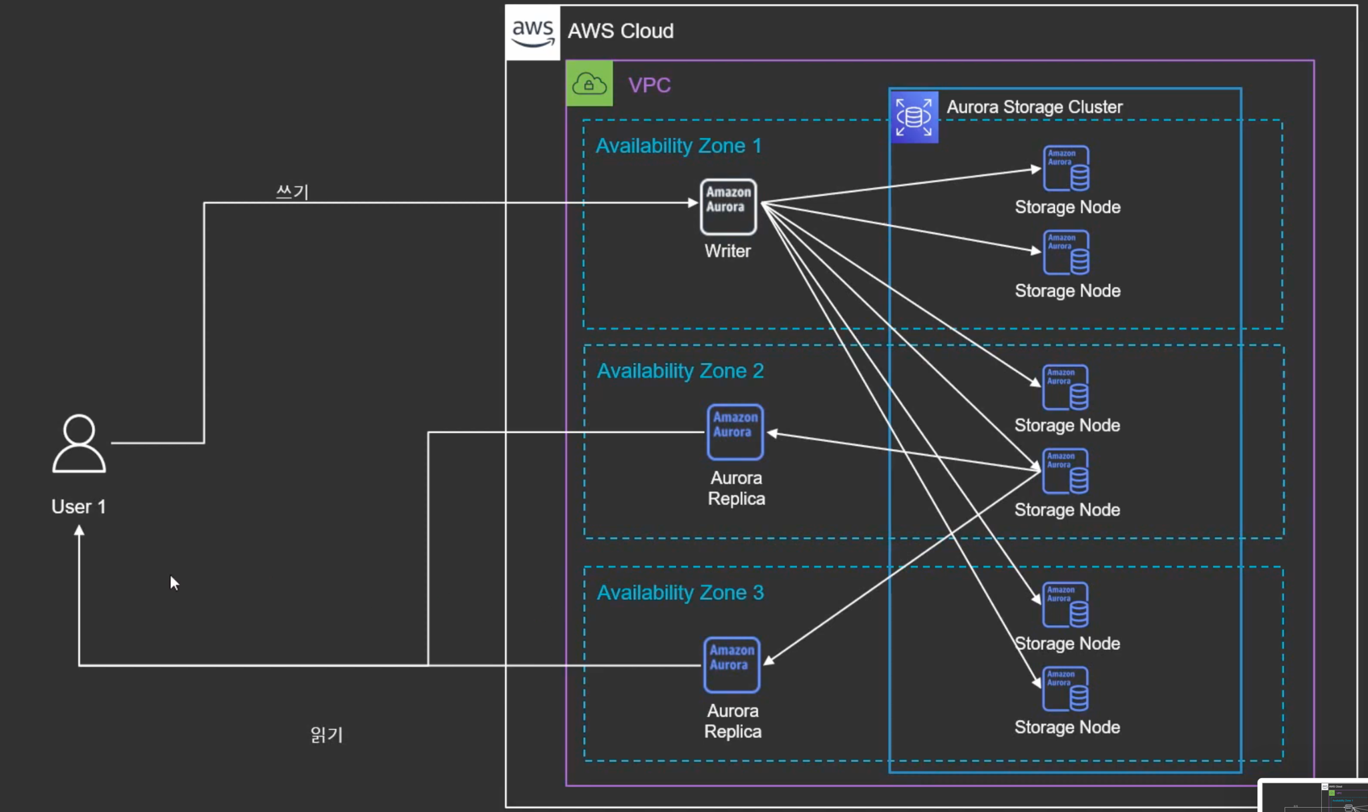
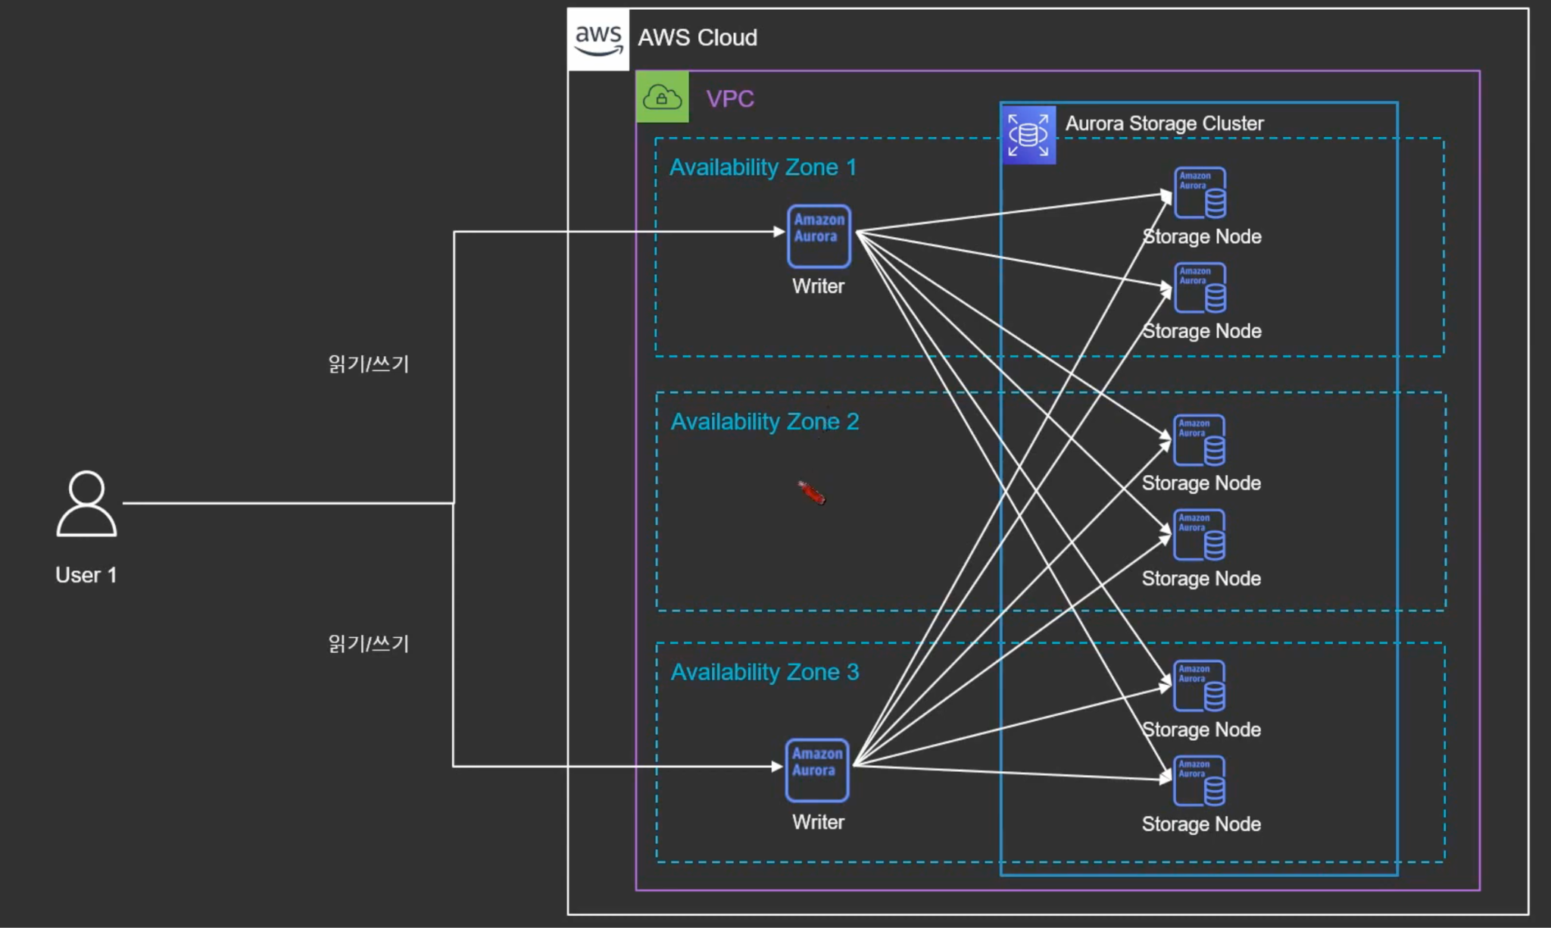
Test Case #4
Storage and Databases
Questions
1. (Eng) There are two database clusters sinking the same data. Cluster A is used for services targeting set top boxes or other dedicated equipment, and cluster B is used for services accessed via mobile, tablet, and website.
- A design proposal is needed for two-way sync between two clusters or one cluster and a legacy cluster on the cloud.
- Description and proposal of integrated database design through Aurora cluster
Notes:
1. 양방향 복제 (Bidirectional Replication):
- DMS는 양방향 복제를 지원하여 두 개의 데이터베이스 간에 상호작용을 가능하게 합니다.
- 데이터베이스 변경 사항을 한쪽에서 다른쪽으로 복제하여 양쪽 데이터베이스를 동기화합니다.
- 이를 위해 변경 데이터 캡처(CDC, Change Data Capture) 메커니즘을 사용하여 변경 사항을 식별하고 전송합니다.
- 양방향 복제는 일반적으로 비동기적으로 작동하며, 데이터의 일관성을 위해 충돌 관리 메커니즘을 사용할 수 있습니다.
2. 다중 마스터 솔루션 (Multi-Master Solution):
- 다중 마스터 솔루션은 여러 데이터베이스 클러스터가 모두 마스터 역할을 수행하여 동시에 쓰기 작업을 처리할 수 있는 구조를 제공합니다.
- 각 클러스터는 독립적으로 작동하며, 쓰기 작업은 해당 클러스터에 수행됩니다.
- 다중 마스터 솔루션은 데이터베이스 샤딩, 복제 프레임워크 또는 특정 데이터베이스 제품의 내장 기능을 사용하여 구현할 수 있습니다.
- 이는 수평적으로 확장 가능하고 분산된 데이터베이스 환경을 구축하는 데 유용합니다.

Slide 21
Test Case #4
Storage and Databases
Aurora cluster overview
Amazon Aurora takes advantage of the cloud native features.
Amazon Aurora uses a purpose built, log structured storage.
Amazon Aurora has built in features like Automated backups, Multi-AZ, Global DB, and more that make it highly resilient to failures.
Features like Backtrack, fast recovery, fast cloning makes it easy to recover from failures.

Slide 22
Test Case #4
Storage and Databases
Aurora cluster design
Scale-out, distributed, multi-tenant storage architecture
Purpose-built log-structured distributed storage
Storage volume is striped across hundreds of storage nodes
Storage nodes with locally attached SSDs
Continuous backup to Amazon S3.
Six copies of data, two in each Availability Zone to protect against AZ+1 failure modes
Storage volume segmented in
10 GiB protection groups (PG)
Each PG contains six 10 GiB segments, copies of the same data on different storage nodes, two in each AZ.
Storage volume grows automatically by adding PGs, up to 128 TiB
CLUSTER STORAGE VOLUME
AZ 1
AZ 2
AZ 3

Slide 23
Test Case #4
Storage and Databases
Aurora cluster design
Scale-out, distributed, multi-tenant storage architecture
Managed DB service, no OS or filesystem level access
Connect to writer using Cluster (DNS) Endpoint – always points to writer!
Round robin load balancing for reads using Cluster Reader (DNS) Endpoint (excludes writer except on single node clusters)
Custom (DNS) Endpoints, read replica auto scaling supported as well
Cluster
Endpoint
Reader
Endpoint
Writer
Reader
Reader
SQL
SQL
SQL
Transactions
Transactions
Transactions
Caching
Caching
Caching
CLUSTER STORAGE VOLUME
AZ 1
AZ 2
AZ 3

Slide 24

Test Case #4
Storage and Databases
Aurora cluster design
Scale-out, distributed, multi-tenant storage architecture
Any reader node can be promoted to writer/primary
Failover tier determines preference on failover reader candidates. Lower values more preferred.
Failed instances/nodes will be replaced after failover and come online as readers.
Cluster
Endpoint
Reader
Endpoint
Writer
Reader
Reader
SQL
SQL
SQL
Transactions
Transactions
Transactions
Caching
Caching
Caching
CLUSTER STORAGE VOLUME
AZ 1
AZ 2
AZ 3

Slide 25
Test Case #4
Storage and Databases
Aurora cluster design
Writes and asynchronous readers
Storage is log structured, Aurora doesn’t flush data pages (or full blocks) to storage
Redo logs (change vectors for data pages) get streamed continuously to storage nodes by writer, in parallel
Redo logs also streamed to readers for buffer pool and read view updates
Low reader lag < ~20ms
Writer
Reader
Reader
SQL
SQL
SQL
Transactions
Transactions
Transactions
Caching
Caching
Caching
CLUSTER STORAGE VOLUME
AZ 1
AZ 2
AZ 3

Slide 26
Test Case #4
Storage and Databases
Aurora cluster design
Traditional read scaling
Amazon Aurora read scaling
Primary
Usually single-threaded
or limited parallelism
(e.g. binlog apply)
Replica
Aurora Writer
Page cache update
Aurora Reader
70% Write
70% Write
70% Write
100% New Reads
30% Read
30% New Reads
30% Read
Data volume
Data volume
Shared Multi-AZ storage
Logical using binary log, or WAL
Same write workload on replica
Independent storage
Physical using page change vectors (redo log)
No writes on replica
Shared storage
Shared: Common MVCC state, efficient for OLTP reads Independent: safe for ad-hoc, long running or risky queries

Slide 27
Test Case #5
Networking

Slide 28
Test Case #5
Networking
PoC Detail
Explain the process and concepts involved in
1. Set up Virtual Private Cloud (VPC) configurations.
2. Test network security and access controls.
3. Evaluate AWS Direct Connect for dedicated network connections.
Expected Result
The proposed solution should explain the process and concepts involved in
1. Set up Virtual Private Cloud (VPC) configurations.
2. Test network security and access controls.
3. Evaluate AWS Direct Connect for dedicated network connections.

Slide 29
Test Case #5
Networking
Questions
1. Transit gateway and VPC Peering compare
- Technical comparison
- Cost comparison

Slide 30
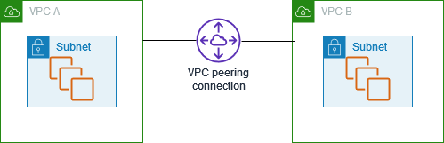
Test Case #5
Networking
VPC Peering
Overview
connection is a networking connection between two VPCs that enables you to route traffic between them privately. Instances in either VPC can communicate with each other as if they are within the same network.
Notes:
참고 링크 : https://medium.com/awesome-cloud/aws-difference-between-vpc-peering-and-transit-gateway-comparison-aws-vpc-peering-vs-aws-transit-gateway-3640a464be2d

Slide 31
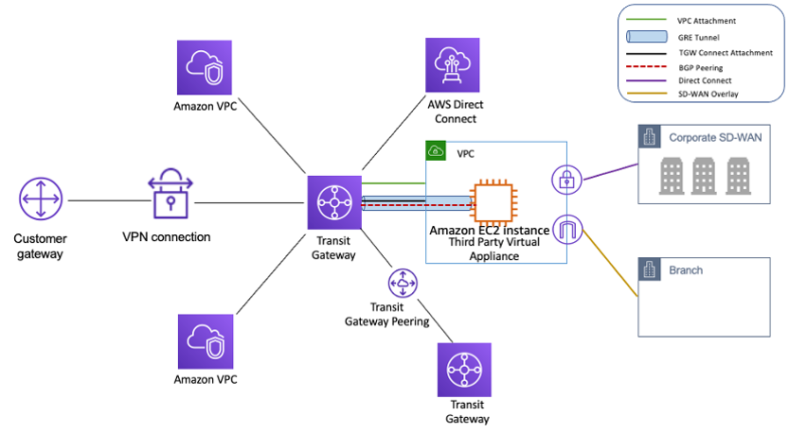
Test Case #5
Networking
Transit Gateway
Overview
AWS Transit Gateway is a fully managed service that connects VPCs and On-Premises networks through a central hub without relying on numerous point-to-point connections or Transit VPC.
You can attach all your hybrid connectivity (VPN and Direct Connect connections) to a single Transit Gateway instance, consolidating and controlling your organization’s entire AWS routing configuration in one place.

Slide 32
Test Case #5
Networking
Advantages
 | Advantages | Disadvantages
VPC peering | Low cost since you need to pay only for data transfer. No limits on bandwidth. | Complex at scale. Each new VPC increases the complexity of the network. Harder to maintain route tables compared to TGW. No transit routing. Maximum 125 peering connections per VPC.
Transit Gateway | Simplified management of VPC connections. Each spoke VPC only needs to connect to the TGW to gain access to other connected VPCs. Supports more VPCs compared to VPC peering. TGW Route Tables per attachment allow for fine-grained routing. | Additional hop introduces some latency. Extra cost of hourly charge per attachment in addition to data fees.

Slide 33
Test Case #5
Networking
Use Cases
Choose VPC Peering if:
Number of VPCs to be connected is lower (~<10).
You need multiple VPCs’ connectivity to On-premises.
You want to minimize data transfer costs when significant volumes of data transfer across regions, VPC Peering is cost-effective.
Need for low latency.
You need high throughput. Network bandwidth requirement is more than 50 Gbps.
Choose Transit Gateway if:
You need VPC connectivity at scale. Number of VPCs to be connected is higher (~>10) or scale in the future as the business grows.
You need network-level segmentation. (possible with multiple TGW route tables)
You need multiple VPCs connectivity to On-premises.

Slide 34
Test Case #5
Networking
TL;DR
VPC Peering and Transit Gateway are used to connect multiple VPCs.
VPC Peering provides Full-mesh architecture while Transit Gateway provides hub-and-spoke architecture.
Transit Gateway gives VPC connectivity at scale and simplifies VPC-to-VPC communication management over VPC Peering with a large number of VPCs.

Slide 35
Test Case #5
Networking
 | VPC Peering | Transit Gateway
Connectivity Options | VPC to VPC. Hybrid connectivity is not supported. | VPC to VPC. Supports hybrid connectivity using VPN or Direct Connect Gateway attachments. Reuse same VPN/DX connection for multiple VPCs.
Architecture | Full Mesh (One to one mapping) | Hub and Spoke
Transitive Routing | Not supported. | Supported
Network Connectivity | Supports Inter-region and Intra-region VPCs connectivity | Supports Inter-region and Intra-region VPCs connectivity
Complexity | Increases with VPC count. You need to set up a VPC Peering between every VPC. Less complexity with a small number of VPC count. | Increases with Transit Gateway count/region count. Less complexity with a higher number of VPC count compares to VPC Peering. You need to manage a very less number of connections/attachments.
Scale | Up to 125 active Peers/VPC | Up to 5,000 Attachments per Region
Bandwidth limit | No limit. | Up to 50 Gbps (burst)/attachment
Latency | Lowest | Slightly higher compared to VPC Peering because of additional Transit Gateway hop
Cost | Data transfer. (operational cost is high) | Data transfer, Data processing, and Hourly per attachment. (operational cost is less)
Visibility/Monitoring | VPC Flow Logs. Limited visibility compared to TGW. | VPC Flow Logs, Transit Gateway Network Manager, CloudWatch Metrics.
Security group (cross-referencing) | Supported | Not supported.

Slide 36
Test Case #5
Networking
Cost comparison
 | VPC Peering | Transit gateway
Price per Connections(Attachments)($) | none | Hour per $0.07
Price per GB of data processed($) | GB per $0.02 (VPC Peering connections across Availability Zones in the same AWS Region is charged at $0.01/GB in each direction) | GB per $0.02
Notes:
https://dev.classmethod.jp/articles/different-from-vpc-peering-and-transit-gateway/
2021년 5월 1일부터 가용 영역(AZ) 내에 유지되는 VPC 피어링 연결을 통한 모든 데이터 전송은 무료
https://aws.amazon.com/ko/about-aws/whats-new/2021/05/amazon-vpc-announces-pricing-change-for-vpc-peering/

Slide 37
Test Case #6
Load Balancing and Scaling

Slide 38
Test Case #6
Load Balancing and Scaling
PoC Detail
Explain the process and concepts involved in
1. Elastic Load Balancers (ELB) and Auto Scaling.
2. Assess how well the system handles traffic spikes.
Expected Result
The proposed solution should explain the process and concepts involved in
1. Elastic Load Balancers (ELB) and Auto Scaling.
2. Assess how well the system handles traffic spikes.

Slide 39
Test Case #6
Load Balancing and Scaling
Questions
1. Why NLB suggestion

Slide 40
Test Case #6
Load Balancing and Scaling
Conclusion: Why suggestion to NLB
We proposal use the NLB(Network Load Balancing), for that AIS IPTV Service has huge user and currently consideration with concurrent transactions by users variety device. Because that AWS NLB Service performance to better than ALB service. ALB is L7 layer focused service, it has a compute processing time for HTTP base traffic distribute. But NLB is L4 layer designed service, it has comprehensive traffic by TCP, UDP and TLS protocol cause that this is performance better than ALB. And NLB doesn't have scaling but ALB need to scaling for throughput to a huge traffic. When have a plan be going to service traffic cut-over to ALB, should be pre-warm request to AWS Service team for prepared scale-out of ALB after should have calculation expected a traffic size on it.

Slide 41
Test Case #6
Load Balancing and Scaling
Application Load Balancer (ALB)
This is the distribution of requests based on multiple variables, from the network layer to the application layer. It is context-aware and can direct requests based on any single variable as easily as it can a combination of variables. Applications are load balanced based on their peculiar behavior and not solely on server (operating system or virtualization layer) information.
This is a feature filled Layer-7 load balancer, HTTP, and HTTPS listeners only. Provides the ability to route HTTP and HTTPS traffic based upon rules, host-based or path based. Like an NLB, each Target can be on different ports. Even supports HTTP/2. Configurable range of health check status codes.
Protocols: HTTP, HTTPS
Protocol versions: HTTP/1.1, HTTP/2, gRPC
Target Types: Instance, IP, Lambda
With ALB, it is a requirement that you enable at least two or more Availability Zones.
https://docs.aws.amazon.com/ko_kr/elasticloadbalancing/latest/application/introduction.html
Notes:
참고 링크 : https://medium.com/awesome-cloud/aws-difference-between-application-load-balancer-and-network-load-balancer-cb8b6cd296a4

Slide 42
Test Case #6
Load Balancing and Scaling
Network Load Balancer (NLB)
This is the distribution of traffic based on network variables, such as IP address and destination ports. It is Layer 4 (TCP) and below and is not designed to take into consideration anything at the application layer such as content type, cookie data, custom headers, user location, or the application behavior. It is context-less, caring only about the network-layer information contained within the packets it is directing this way and that.
This is a TCP Load Balancer only that does some NAT magic at the VPC level. It uses EIPs, so it has a static endpoint unlike ALB. Each Target can be on different ports.
Protocols: TLS, TCP, UDP, TCP_UDP
Protocol versions: TLS, TCP, UDP, TCP_UDP
Target Types: Instance, IP, ALB
With NLB, Elastic Load Balancing creates a network interface for each Availability Zone that you enable.
https://docs.aws.amazon.com/ko_kr/elasticloadbalancing/latest/network/introduction.html
Notes:
참고 링크 : https://medium.com/awesome-cloud/aws-difference-between-application-load-balancer-and-network-load-balancer-cb8b6cd296a4

Slide 43
Test Case #6
Load Balancing and Scaling
Comparison ALB and NLB
 | ALB | NLB
OSI Layer | works at the Application Layer (Layer 7 of the OSI model, Request level) | works at the Transport layer (Layer 4 of the OSI model, Connection level)
Routing | examines the contents of the HTTP request header to determine where to route the request. So, an ALB support advanced request (content-based) routing. | just forward requests
Static IP | Not Support | provides support for zonal static IP addresses (in each AZ).
PrivateLink (Endpoint services) | Not support PrivateLink. But supports forwarding traffic directly from NLB to ALB. With this feature, you can now use AWS PrivateLink and expose static IP addresses for applications built on ALB. | provides support for PrivateLink with VPC Endpoints Service integration. Only NLB can be used directly as PrivateLink
AWS Load Balancer Controller for Kubernetes | create a Kubernetes Ingress | create a Kubernetes service of type LoadBalancer
Notes:
참고 링크 : https://medium.com/awesome-cloud/aws-difference-between-application-load-balancer-and-network-load-balancer-cb8b6cd296a4

Slide 44
Test Case #6
Load Balancing and Scaling
Comparison ALB and NLB
 | ALB | NLB
Application availability | ALB goes much deeper and is capable of determining availability based on not only a successful HTTP GET of a particular page but also the verification that the content is as was expected based on the input parameters. | NLB cannot assure the availability of the application. This is because it bases its decisions solely on a network and TCP-layer variables and has no awareness of the application at all. Generally, NLB determines availability based on the ability of a server to respond to ICMP ping or to correctly complete the three-way TCP handshake.
 | ALB will differentiate between two applications by examining the application layer data available to it. | When considering the deployment of multiple applications on the same host sharing IP addresses (virtual hosts), NLB will not differentiate between Application-A and Application-B when checking availability (indeed it cannot unless ports are different)
Security | support Security Groups | support Security Groups (Updates on Aug 10, 2023, Network Load Balancer now supports security groups)
Notes:
참고 링크 : https://medium.com/awesome-cloud/aws-difference-between-application-load-balancer-and-network-load-balancer-cb8b6cd296a4

Slide 45
Test Case #6
Load Balancing and Scaling
Use Case
Choose ALB if:
Application Load Balancer is best suited for load balancing of HTTP and HTTPS traffic and provides advanced request routing targeted at the delivery of modern application architectures, including microservices and containers.
Applications need advanced routing (host-based, URL-based, query string based).
Run multiple services (microservices) behind a single load balancer.
Choose NLB if:
Network Load Balancer is best suited for load balancing of TCP traffic where extreme performance is required. It is capable of handling millions of requests per second while maintaining ultra-low latencies, and it is optimized to handle sudden and volatile traffic patterns.
You want to share/expose your services (e.g. SaaS services) to other consumers in different VPCs using PrivateLink VPC Endpoint.
You need a static IP address that can be used by applications as the front-end IP of the load balancer.
Notes:
참고 링크 : https://medium.com/awesome-cloud/aws-difference-between-application-load-balancer-and-network-load-balancer-cb8b6cd296a4

Slide 46
Test Case #7
Monitoring and Logging

Slide 47
Test Case #7
Monitoring and Logging
PoC Detail
Explain the process and concepts involved in
1. Amazon CloudWatch for monitoring.
2. Set up alarms and notifications for resource utilization.
3. Centralized logging with services e.g. Amazon CloudWatch Logs.
Expected Result
The proposed solution should explain the process and concepts involved in
1. Amazon CloudWatch for monitoring.
2. Set up alarms and notifications for resource utilization.
3. Centralized logging with services e.g. Amazon CloudWatch Logs.

Slide 48
Test Case #7
Monitoring and Logging
Questions
1. For what purpose do you use CloudWatch or Kibana?
-> (Answer completed) Using CloudWatch when monitoring AWS Managed

Slide 49
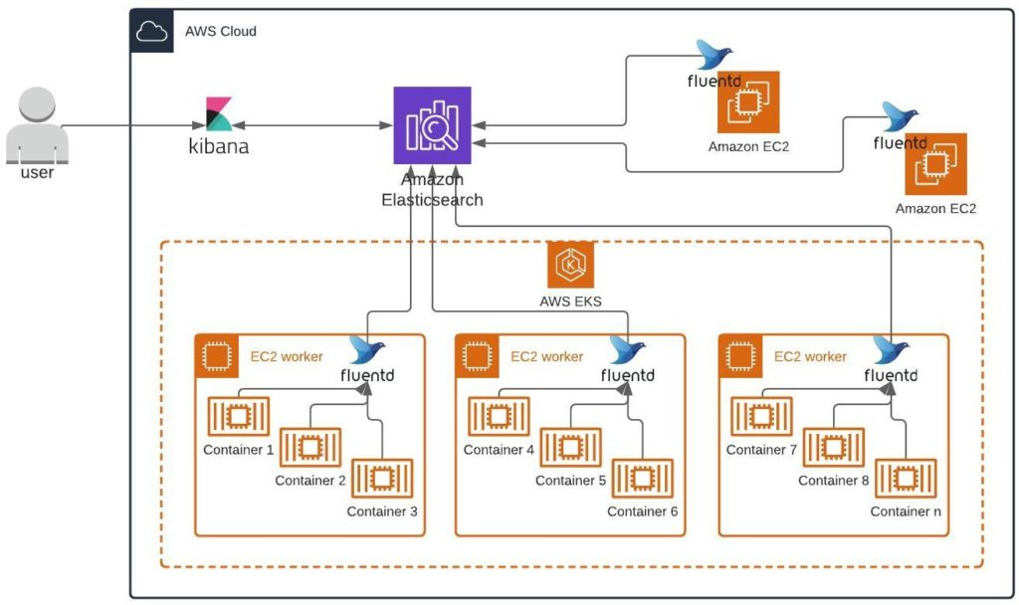
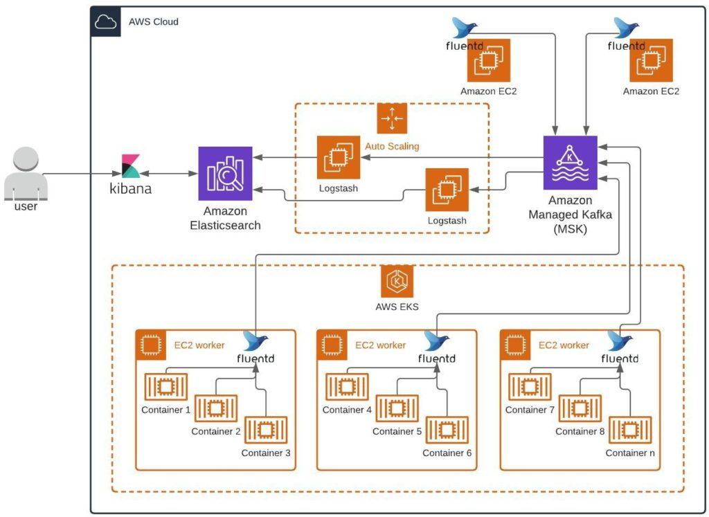
Test Case #7
Monitoring and Logging
Opensearch service integration Application logs
For bigger production environments, we recommend using Logstash and adding a caching tier before data goes to Elasticsearch for processing. Apache Kafka works well here for buffering incoming log streams from containers. AWS has a fully managed service, AWS MSK, that enables users to get up and running immediately with Kafka. The combination of Kafka, MSK, and Logstash is ideal for processing large volumes of incoming logs.

Slide 50
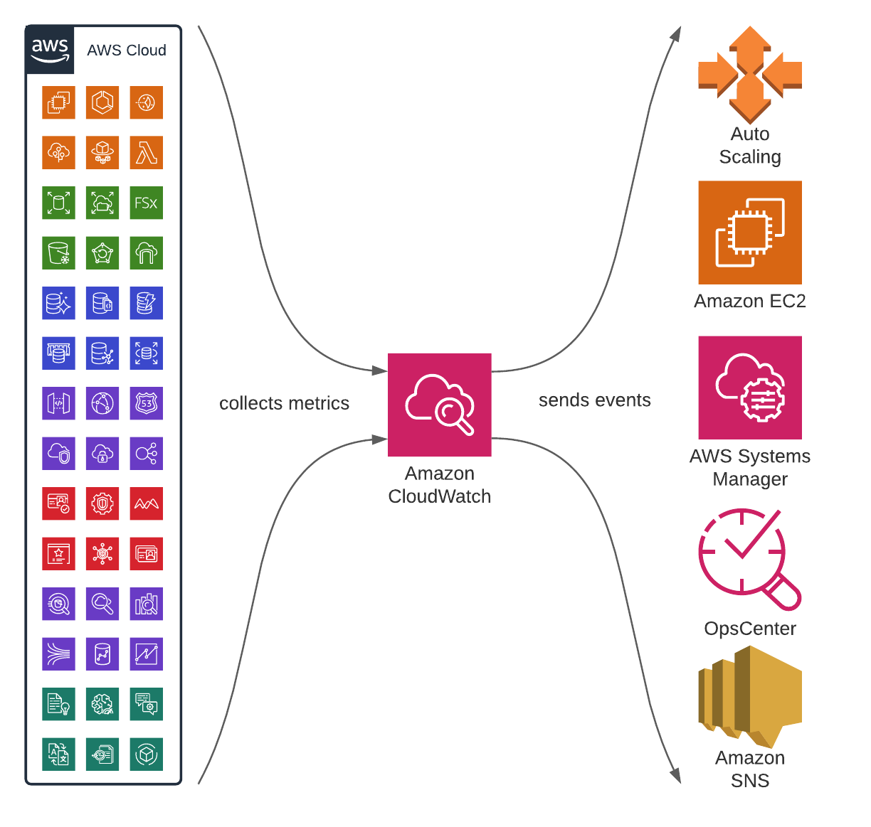
Test Case #7
Monitoring and Logging
CloudWatch gather AWS Services logs
Amazon CloudWatch is an AWS monitoring service for cloud resources and the applications that you run on AWS. You can use Amazon CloudWatch to collect and track metrics, collect and monitor log files, and set alarms. Amazon CloudWatch can monitor AWS resources, such as Amazon EC2 instances, Amazon DynamoDB tables, and Amazon RDS DB instances, in addition to custom metrics generated by your applications and services, and any log files that your applications generate, hosted on premises, hybrid, or on other clouds. You can use Amazon CloudWatch to gain system-wide visibility into resource utilization, application performance, and operational health. You can use these insights to react and keep your application running smoothly.

Slide 51

Test Case #8
Security and Identity Access Management(IAM)

Slide 52
Test Case #8
Security and Identity Access Management(IAM)
PoC Detail
Explain the process and concepts involved in
1. IAM roles and policies used in the project.
2. Security best practices and access controls.
3. Evaluate AWS Identity and Access Management (IAM) policies.
Expected Result
The proposed solution should explain the process and concepts involved in
1. IAM roles and policies used in the project.
2. Security best practices and access controls.
3. Evaluate AWS Identity and Access Management
(IAM) policies.

Slide 53
Test Case #8
Security and Identity Access Management(IAM)
CDC Team follow

Slide 54
Test Case #9
Content Delivery

Slide 55
Test Case #9
Content Delivery
PoC Detail
Explain the process and concepts involved in Amazon CloudFront for content delivery.
Expected Result
The proposed solution should explain the process and concepts involved in Amazon CloudFront for content delivery.

Slide 56
Test Case #9
Content Delivery
Question
1.Do you plan to use Cloudfront for this proposal and design?
(Answer completed)
After discussion on migration and cost, to be confirmed later, business issue, not technical issue
2. What files will be cached in the current project? Is there any other content worth caching?

Slide 57
Test Case #9
Content Delivery
Cacheable content
CloudFront caches responses that meet all of the requirements in this section. Some of these requirements are specified by RFC 7234, and others are specific to CloudFront. May periodically change the exact set of conditions under which it caches content. If you want to explicitly prevent CloudFront from caching your content, follow the guidelines in RFC 7234 to determine how to specify a guaranteed-uncacheable response.
Cloud CDN stores responses in cache if all of the following are true. (Next Deck)

Slide 58
Test Case #9
Content Delivery
Attribute | Requirement
Served by | Backend service, backend bucket, or an external backend with Cloud CDN enabled
In response to | GET request
Status code | 200, 203, 204, 206, 300, 301, 302, 307, 308, 404, 405, 410, 421, 451, or 501.
Freshness | The response has a Cache-Control header with a max-age or s-maxage directive, or an Expires header with a timestamp in the future. For cacheable responses without an age (for example, with no-cache), the public directive must be explicitly provided. With the CACHE_ALL_STATIC cache mode, if no freshness directives are present, a successful response with static content type is still eligible for caching. With the FORCE_CACHE_ALL cache mode, any successful response is eligible for caching. This might result in caching of private, per-user (user identifiable) content. You should only set FORCE_CACHE_ALL on backends that aren't serving private or dynamic content, such as Cloud Storage buckets. If negative caching is enabled and the status code matches one for which negative caching specifies a TTL, the response is eligible for caching, even without explicit freshness directives.
Content | Contains a valid Content-Length, Content-Range, or Transfer-Encoding: chunked header. For example, a Content-Length header that correctly matches the size of the response.
Size | Less than or equal to the maximum size. For responses with sizes between 10 MB and 100 GB, see the additional cacheability constraints described in byte range requests.

Slide 59
Test Case #10
High Availability and Disaster Recovery

Slide 60
Test Case #10
High Availability and Disaster Recovery
PoC Detail
Explain the process and concepts involved in multi- region redundancy and failover and disaster recovery scenarios using AWS Backup and AWS Site-to-Site VPN.
Expected Result
The proposed solution should explain the process and concepts involved in multi-region redundancy and failover and disaster recovery scenarios using AWS Backup and AWS Site-to-Site VPN.

Slide 61
Test Case #10
High Availability and Disaster Recovery
Question
1.Are you planning to apply DR to this project?
(Answer completed) Scheduled to be applied in actual configuration
2. Please estimate the cost of building DR. If there is a guide for calculating the cost, please let us know.
1) Start service for DB replication purposes
2) EC2 is scheduled to stop to reduce costs
3) Cost calculation is required for plan 1 (Active-Stanby) and plan 2 (Active-Active) respectively.
3. What is the expected conversion time if a failure occurs after DR configuration?
(Answer completed) It is determined by each item below, and actual measurement is required.
1) DB size
2) Service boot time
3) In actual service, it is not automated and requires approval from an administrator with decision authority.
4. For RPO/RTO, please provide customer evaluation items and necessary items for RPO/RTO calculation.
1) Set the backup cycle (additional costs are incurred each time you back up)
2) First, check the external/internal use status of the client's IP. When moving the public IP to another region -> it is necessary to check the IP that changes.

Slide 62
Test Case #10
High Availability and Disaster Recovery
DR Offer Scope
1.Are you planning to apply DR to this project?
(Answer completed) Scheduled to be applied in actual configuration
2. Please estimate the cost of building DR. If there is a guide for calculating the cost, please let us know.
1) Start service for DB replication purposes
2) EC2 is scheduled to stop to reduce costs
3) Cost calculation is required for plan 1 (Active-Stanby) and plan 2 (Active-Active) respectively.
3. What is the expected conversion time if a failure occurs after DR configuration?
(Answer completed) It is determined by each item below, and actual measurement is required.
1) DB size
2) Service boot time
3) In actual service, it is not automated and requires approval from an administrator with decision authority.
4. For RPO/RTO, please provide customer evaluation items and necessary items for RPO/RTO calculation.
1) Set the backup cycle (additional costs are incurred each time you back up)
2) First, check the external/internal use status of the client's IP. When moving the public IP to another region -> it is necessary to check the IP that changes.

Slide 63
Test Case #11
Cost Management

Slide 64
Test Case #11
Cost Management
PoC Detail
Explain the process and concepts involved in monitoring and analyzing costs using AWS Cost Explorer and implement cost-saving strategies like Reserved Instances.
Expected Result
The proposed solution should explain the process and concepts involved in monitoring and analyzing costs using AWS Cost Explorer and implement cost-saving strategies like Reserved Instances.

Slide 65
Test Case #12
Compliance and Governance

Slide 66
Test Case #12
Compliance and Governance
PoC Detail
Explain the process and concepts involved in industry- specific regulations and AWS organizations for multi-account management.
Expected Result
The proposed solution should explain the process and concepts involved in industry-specific regulations and AWS organizations for multi- account management.

Slide 67
Test Case #13
Integration and APIs

Slide 68
Test Case #13
Integration and APIs
PoC Detail
Explain the process and concepts involved in AWS API Gateway for creating and managing APIs
Expected Result
The proposed solution should explain the process and concepts involved in AWS API Gateway for creating and managing APIs

Slide 69
Test Case #13
Integration and APIs
Required
BEAST API Gateway User and Development guide document(en)

Slide 70
Test Case #13
Integration and APIs
answerd by KTDS
1.Beast API G/W role? purpose of use?
Authentication, authorization, authentication key issuance, login control, routing, LB, limit management, service management, user authority management, IP list management, etc.
The purpose of use is MSA
2. On what basis was Beast API G/W developed?
Spring G/W based
3.What does SLA Policy min/minutes mean?
and/or
4. Processing when the limit is exceeded
Queuing, logging, message provision
5.Please tell me about the communication path?
Set top -> AWS auth -> AWS proxy -> API G/W -> MBS
6. The service will not work with just one Beast Pod. Can you please tell me how to handle the large volume of traffic without an expansion plan?
Based on 1Core=200 TPS, Pod resources will be expanded by the number of concurrent users

Slide 71
Test Case #14
Deployment and CI/CD

Slide 72
Test Case #14
Deployment and CI/CD
PoC Detail
Explain the process and concepts involved in
1. continuous integration and continuous deployment (CI/CD) pipelines using CI/CD tool e.g. AWS CodePipeline and AWS CodeDeploy or even Github action.
2. Deployment automation and rollbacks
Expected Result
The proposed solution should explain the process and concepts involved in
1. continuous integration and continuous deployment (CI/CD) pipelines using CI/CD tool e.g. AWS CodePipeline and AWS CodeDeploy or even Github action.
2. Deployment automation and rollbacks

Slide 73
Test Case #14
Deployment and CI/CD
Question
1. Is it possible to change to GitHub instead of AWS codecommit?
(Answer completed)
Yes

Slide 74
Test Case #15
Scalability and Performance

Slide 75
Test Case #15
Scalability and Performance
PoC Detail
concepts involved in
1. Load tests to evaluate system performance and scalability.
2. Deploying and scaling applications service e.g. AWS Elastic Beanstalk
Expected Result
The proposed solution should explain the process and concepts involved in
1. Load tests to evaluate system performance and scalability.
2. Deploying and scaling applications service e.g. AWS Elastic Beanstalk

Slide 76
Test Case #15
Scalability and Performance
Question
1. How much traffic have you set for each pod?
KTds > Designed to handle 200 users (200TPS) per pod
2. After EKS HPA Metric Pod Scale-out, how can I check the improved Pod metrics and performance improvement status?
MZC > When a test scenario suitable for use of the service is provided by the customer, You can check by conducting a load test according to the scenario set in the development environment.

Slide 77
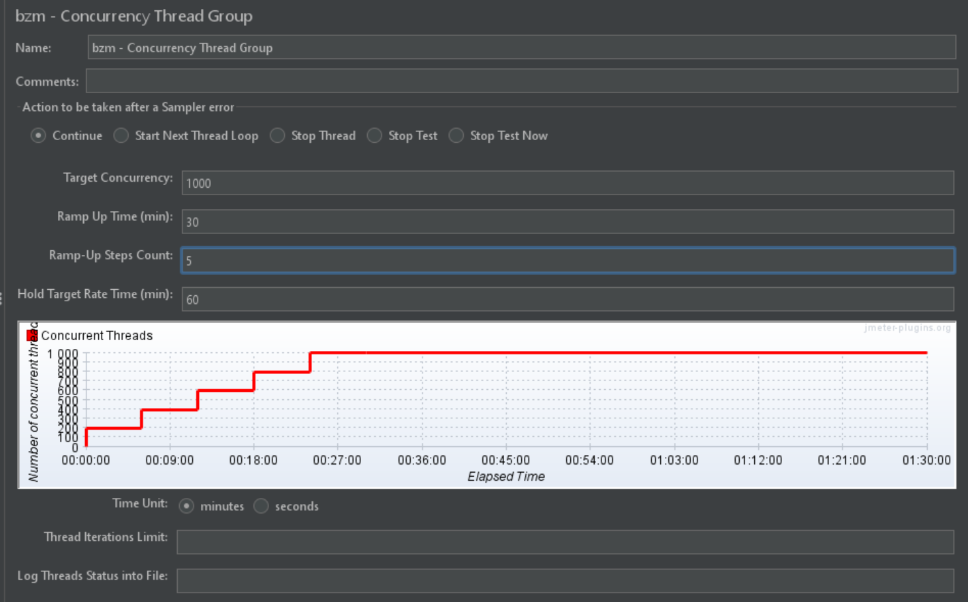
Test Case #15
Scalability and Performance
Question
1. How much traffic have you set for each pod?
--> Designed to handle 200 users (200TPS) per pod
2. After EKS HPA Metric Pod Scale-out, how can I check the improved Pod metrics and performance improvement status?
--> When a test scenario suitable for use of the service is provided by the customer,
You can check by conducting a load test according to the scenario set in the development environment.

Slide 78
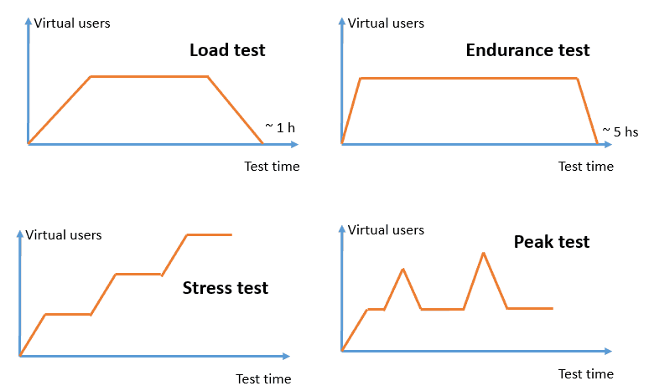
Test Case #15
Scalability and Performance
Load test
The process of injecting a load into a service that is similar to the pattern used by end users to verify that the service runs normally.
The purpose of a load test is to verify the reliability and performance of a service by injecting a fixed amount of load.
Stress testing aims to identify faults or bugs by intentionally overloading the service and causing it to behave abnormally.
Because they load the service beyond its limits, the results can be skewed and may be far from the load patterns experienced by real users.
Should be aware that large-scale tests require a sophisticated infrastructure to create valid results. This will also lead to significant costs that should be considered.

Slide 79
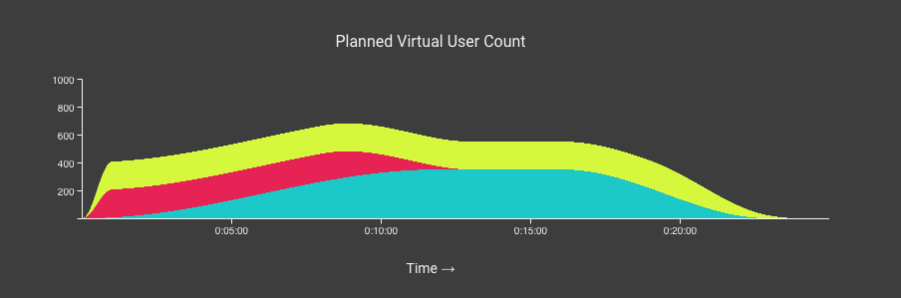
Test Case #15
Scalability and Performance
Load Test Scenarios
A load test scenario should be realistic. That is, the mix of behaviors (scripts) should be similar to what you can expect from your real users. If you go to the trouble of load testing, but simulate unrealistic behaviors or traffic patterns, the test results might be kind of useless.
It is up to you, to determine what user behaviors are most realistic and relevant for your site.
For example, at any given moment, your online site might have:
400 users browsing the web site service
150 users adding IPTV contents to cart and checking out
150 users viewing their account and past orders
Three groups peaking at 700 concurrent users, with different durations

Slide 80
Test Case #15
Scalability and Performance
Load test tools
K6
K6 is a free tool that offers support, hosting of the load source, and an integrated web interface to organize, run, and analyze load tests.
Vegeta
The Vegeta load test follows a different concept. Instead of defining concurrency or throwing load at your system, you define a certain rate. The tool then creates that load independent of your system's response times.
Hey and ab
Hey and ab, the Apache HTTP server benchmarking tool, are basic tools that you can use from the command line to run the specified load on a single endpoint. This is the fastest way to generate load if you have a server to run the tools on. Even a local laptop will perform, although it might be not powerful enough to produce high load.
Apache JMeter (Will be use this tool)
Apache JMeter is the seasoned power horse. Over the years, Apache JMeter has become more reliable and has added features. With the graphical interface, you can create complex tests without knowing a programming language. Companies such as BlazeMeter support Apache JMeter.
Distributed Load Testing on AWS
Distributed Load Testing on AWS solution supports the use of custom Apache JMeter scripts. When you use the Distributed Load Testing on AWS solution, you can upload your Apache JMeter script to run your tests in the cloud. Another benefit is the output support. You can stream the events to time stream databases and run advanced queries on top, giving you detailed insight into your complete test run.

Slide 81
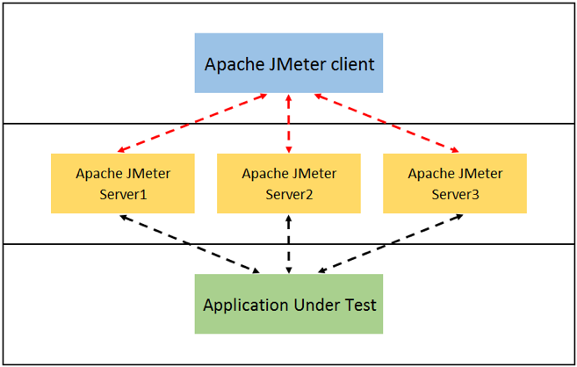
Test Case #15
Scalability and Performance
Load test tools - Apache JMeter (Will be use this tool)
AWS Infra capabilities as well as the Test Plan design will both impact the number of threads you can effectively run with JMeter. The number will also depend on how fast your server is (a faster server makes JMeter work harder since it returns a response quicker). As with any Load Testing tool, if you don't correctly size the number of threads, you will face the "Coordinated Omission" problem which can give you wrong or inaccurate results. If you need large-scale load testing, consider running multiple CLI JMeter instances on multiple machines using distributed mode (or not). When using distributed mode the result file is combined on the Controller node, if using multiple autonomous instances, the sample result files can be combined for subsequent analysis.
For testing how JMeter performs on a given platform, the JavaTest sampler can be used. It does not require any network access so can give some idea as to the maximum throughput achievable.

Slide 82
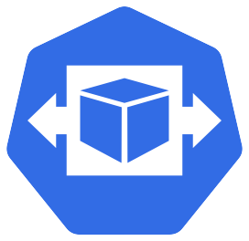





Test Case #15
Scalability and Performance
Scaling applications with Kubernetes
Horizontal Pod Autoscaling (HPA)
Vertical Pod Autoscaling (VPA)
Cluster Autoscaler (CAS)
HPA
Metrics
Store
NOT USE IN PROJECT
VPA
X
Pending pods
CAS

Slide 83
Test Case #16
Data transfer and migration

Slide 84
Test Case #16
Data transfer and migration
PoC Detail
Explain the process and concepts involved in migrate existing applications and data to AWS
Expected Result
The proposed solution should explain the process and concepts involved in migrate existing applications and data to AWS

Slide 85
Test Case #16
Data transfer and migration
Question
Please tell us about the recommended service when converting RDS from Legacy data to Cloud.
(Answer completed) AWS DMS suggestion (Data)

Slide 86
Test Case #16
Data transfer and migration
Overview the AWS DMS(Database Migration Service)
Keep your application running during migration
Simple to use
Minimal downtime
Supports widely used databases
Low cost
Fast and easy to setup
Reliable

Slide 87






Test Case #16
Data transfer and migration
Keep your application running during migration
On-Premise
AWS Cloud
Generic database
DB Instance
Start a replication instance
Let DMS create the target objects
Connect to the source and target
Move data and synchronize objects
Select tables, schemas, or databases
Switch applications when ready

Slide 88
Test Case #16
Data transfer and migration
DMS – change data capture (CDC)
“No Touch” design
Reads recovery log of source database
Using the engine’s native change data capture API
No agent required on the source
Changes captured as transactions and applied in order
Activated when load starts
Changes are applied after initial load is complete
Some requirements
Oracle: Supplemental logging required
MySQL: Full image row level bin logging required
SQL Server: Recovery model bulk logged or full
Postgres: wal_level = logical; max_replication_slots >= 1; max_wal_Senders >=1; wal_sender_timeout = 0

Slide 89
Test Case #16
Data transfer and migration
Migration scenarios
DMS Creates tables and primary keys using Drop tables on target
Manually add secondary indexes and foreign key objects after initial load has completed.
Steps to migrate - overview
Start the full load
While loading data, also capture changes
Load complete - apply captured changes
Changes reach steady state
Shutdown apps and apply remaining changes
Change your application endpoint

Slide 90
Test Case #16
Data transfer and migration
Steps to migrate
Start the full load
Source
Target
Replication Instance

Slide 91
Test Case #16
Data transfer and migration
Steps to migrate
While loading data also capture changes
App
Replication Instance
Source
Target

Slide 92
Test Case #16
Data transfer and migration
Steps to migrate
Load complete - apply captured changes
App
Replication Instance
Source
Target

Slide 93
Test Case #16
Data transfer and migration
Steps to migrate
Changes reach steady state
App
Replication Instance
Source
Target

Slide 94
Test Case #16
Data transfer and migration
Steps to migrate
Shutdown apps and apply remaining changes
App
Replication Instance
Source
Target

Slide 95
Test Case #16
Data transfer and migration
Steps to migrate
Change your application endpoint
App
Replication Instance
Source
Target

Slide 96
Test Case #17
Backup and Recovery

Slide 97
Test Case #17
Backup and Recovery
PoC Detail
Explain the process and concepts involved in
1. Backup and recovery strategies for critical data.
2. AWS Backup or custom backup solutions.
Expected Result
The proposed solution should explain the process and concepts involved in
1. Backup and recovery strategies for critical data.
2. AWS Backup or custom backup solutions.

Slide 98
Test Case #17
Backup and Recovery
Question
1. RDS recommended cycle and backup schedule guide and please.
(Answer completed)
Daily: Incremental / weekend idle time: full backup
2. Please tell us the backup target and method.
(Answer completed)
Target: DB/EC2/Container Image
Backup storage: Save to Snapshot and S3
3. Please explain the method and decision factors during recovery process and rollback.
(Answer completed)
Backup is a regional service
DR is a cross-region method
Rollback possible with snapshot
When restoring RDS, it is restored as a new instance. Restoration time is determined depending on the data size.

Slide 99
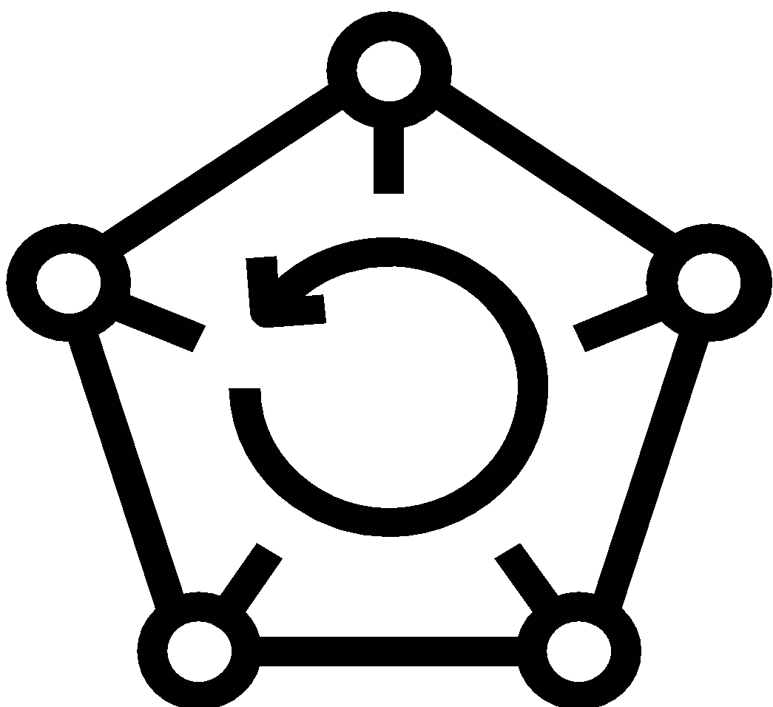
Test Case #17
Backup and Recovery
AWS Backup – meeting the challenges
Backup operations unified across AWS services
Complexity
Compliance
Cost
Simple & Performant
Reliable & Secure
Cost Effective
Policy- and tag-based backup solution
Centralized backup activity monitoring and logs
No added cost for orchestration
Automated backup retention management
Backup access policies
Backup encryption
Automated backup scheduling
Notes:
Complexity - when AWS built these DP services, they used the same underlying microservices, but the management was all one-off. Customers solve this via pro-serve, their own scripting, or consulting services. Add in the many brains and hands needed to manage all that, and complexity increases steadily.
Compliance - Most of our customers use more than one service. If they are using EFS, chances are they are using EBS too, or RDS or Aurora. Every organization has an eye toward compliance, and with the rapid adoption of different services, your overall backup plans, and compliance, can get difficult to manage if you’re not careful.
Cost - The problem and challenge that resulted from all this fast growth in the AWS cloud is where some of our customers needed to contract a lot of professional services, and keep a close eye on managing things to make sure they remain in compliance with regulators, and on-plan with their DR operations. Trying to maintain consistent policies and everything is where we saw a lot of demand start to occur. They didn’t have a lot of options, lots of scripting, manual operations, a lot of inefficiency that could be automated and fully managed – which is where AWS Backup comes in.

Slide 100



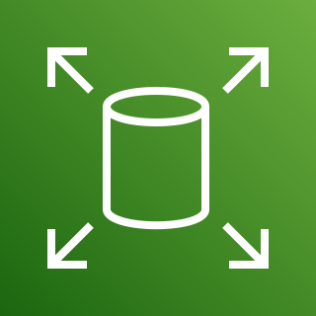




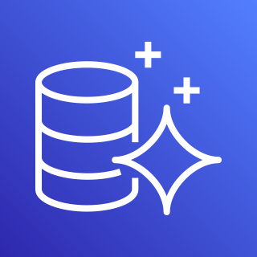














Test Case #17
Backup and Recovery
How AWS Backup works
Supported AWS Services
FSx for
Windows
FSx for
Lustre
With AWS Backup, you can:
Create backup plans that orchestrate backup operations per policy
Secure backups and manage restore processes
Control access for managed resources via IAM
Setup notifications/logging via Amazon SNS, AWS CloudTrail & AWS CloudWatch
Scale through AWS Organizations
Protect EC2 Windows/SQL with app consistency
Backup to other accounts to protect against multiple threats
EBS
EC2
EFS
Operators
AWS
Organizations
RDS
Aurora
DynamoDB
Storage Gateway
AWS IAM
Cross Account Backup
Backups
Backup
Plan
Admin
AWS CloudTrail
Amazon CloudWatch
Amazon SNS
AWS Backup
Backup Vault
Notes:
Covering 9 services now – we plan to cover all stateful services over time.
We bring a lot of free, no charge functionality under the hood that automates, orchestrates and removes complexity. Such as our integrations with AWS Orgs, CloudWatch, EventBridge, CloudTrail, SNS.
MAIN attraction to our customers has been the cloud native aspect. Working in the cloud with the same microservices. Being able to bring in other integrations as needed.
Other discussion – Why customers use AWS Backup:
Fixes the issue limited choices within the individual service consoles
Avoid scripting and other tooling
Unify backup solutions where possible
Avoid the complexity of on-premises backups being done by different groups
Separate IAM controls for all roles
Lock down roles and credentials for access
Reduces threat vectors on your data
Helps DBAs, Storage Admins and Application devs to stay compliant
Maintains centralized control for organization
CloudWatch, CloudTrail & SNS integration
Create audit and compliance alerts, reports, dashboards across all backups

Slide 101
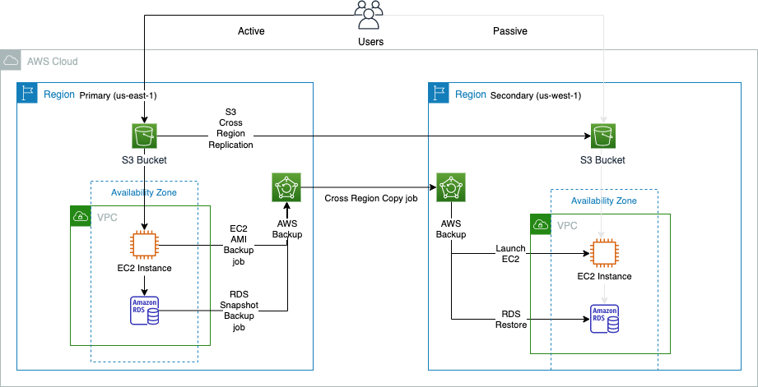
Test Case #17
Backup and Recovery
Use case
This case takes advantage of AWS Backup which will be our single pane of glass to backup, copy and restore our Amazon EC2 instance and Amazon RDS database to the secondary region. And will use Amazon S3 Cross-Region Replication (CRR) to replicate our S3 objects to the secondary region.

Slide 102
Test Case #18
AWS Marketplace Solutions

Slide 103
Test Case #18
AWS Marketplace Solutions
PoC Detail
Explain the process and concepts involved in third-party solutions available in the AWS Marketplace.
Expected Result
The proposed solution should explain the process and concepts involved in third-party solutions available in the AWS Marketplace.

Slide 104
Test Case #18
AWS Marketplace Solutions
Question
1. Do you plan to use the Market place solution in this project?
Answer complete: There are currently no plans to use it.
[After completing 18 test case items, additional questions]
2. Inner Architecture within the EKS Cluster - Is it possible to share spec information such as Pods?
(Answer completed)
AIS demand survey provided (Excel).xlsx
3.Is it possible to share documents related to the Beast system?
(Answer completed)
English manual available

